Slide 1




GitHub to Azure Serverless Automatically
Frank Boucher
Cloud Advocate
@fboucheros

Slide 2
Resources
Session Resources Hub
aka.ms/AFUN95
Session Code on GitHub
aka.ms/AFUN95Repo

Slide 3

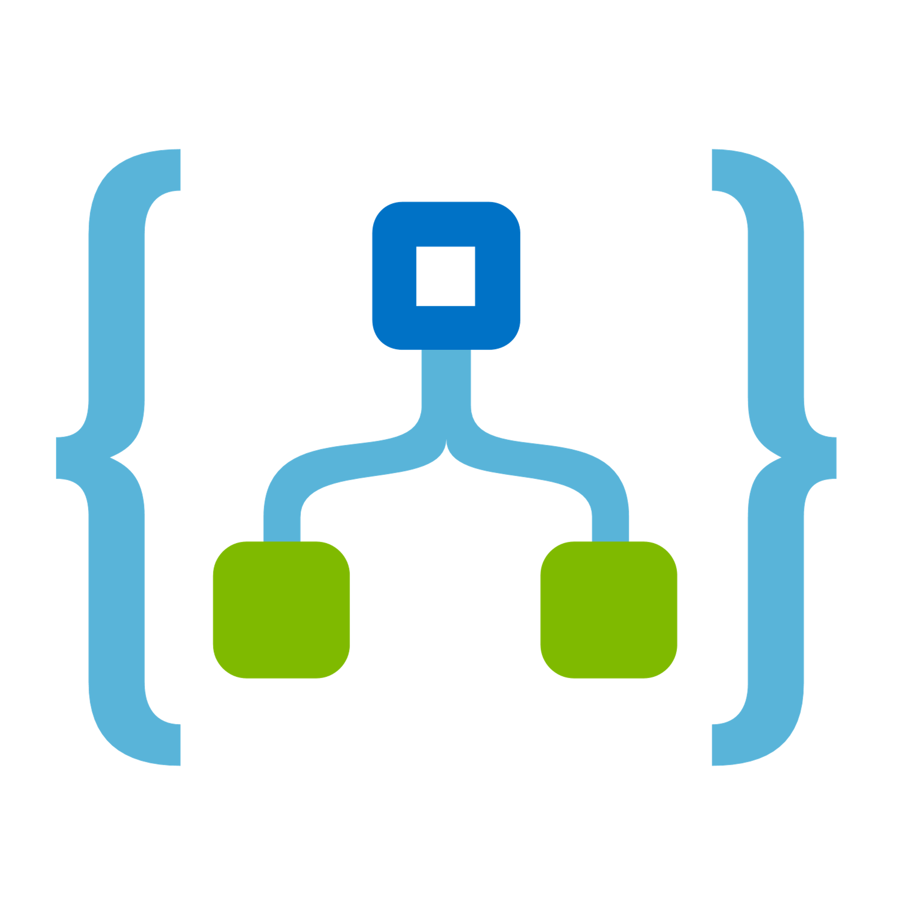
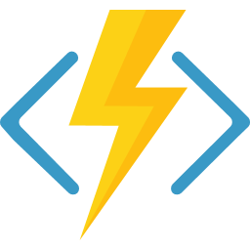
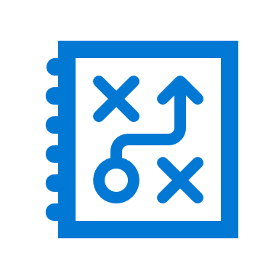
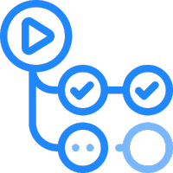
Takeaways
Understand what is serverless
Build an Azure Logic App
Create an Azure Functions
Make them work all together
Be able to use GitHub Actions to deploy to Azure

Slide 4
Introduction to Serverless

Slide 5
Server
less
Notes:
What we should understand in “serverless” it’s that it just mean less server… NOT no server.
There will always have servers, it’s just that we will be able to focus more on the code instead of the infrastructure.
Let me explain

Slide 6
What is the right size of
servers for my business needs?
How do I deploy new code to my server?
What media should I
use to keep backup?
What happens in case of
server hardware failure?
Which packages should be on my server?
What size of servers
should I buy?
Who monitors
my app?
How often should I backup my server?
How can I scale my app?
How can I increase server utilization?
Who has physical
access to my servers?
Which OS should I use?
Do I need secondary network connection?
Are my server in a
secure location?
What happens if the
power goes out?
Who monitors
my Servers?
Do I need a UPS?
What storage I need to use?
How many servers
do I need?
How can I dynamically configure my app?
It takes how long to provision a new server?
How often should
I patch my servers?
On-premises
The “evolution” of application platforms
Notes:
There is so much talk about the cloud that sometimes it’s easy to forget it all began (and still exists) in the data center. Fortunately, not many of us have to configure physical servers and install them in the data center. Taking on that responsibility means a lot of questions to answer. Everything from “how do I secure physical access” to “what happens when the power goes out?” These are questions and steps that distract from the focus of building good software but must be addressed for on-premises installations to be successful.

Slide 7
What is the right size of servers for my business needs?
How can I increase server utilization?
How many servers do I need?
How can I scale my app?
How often should I patch my servers?
How do I deploy new code to my server?
How often should I backup my server?
Which OS should I use?
Which packages should be on my server?
Who monitors my app?
On-premises
IaaS
The “evolution” of application platforms
Notes:
Fortunately virtualization came to the rescue. One great thing about the cloud evolution is that each phase leads to less waste. Infrastructure as a Service leverages hardware in a way that you can stop worrying about the hardware and focus on the operating system and your virtual machines. You can get better utilization of your resources and it’s faster and easier to provision new instances. IaaS addresses many of the questions we dealt with on-premises, and more importantly paves the way to the cloud.

Slide 8
What is the right size of “servers” for my business needs?
How can I increase “server” utilization?
How many “servers” do I need?
How can I scale my app?
On-premises
IaaS
PaaS
The “evolution” of application platforms
Notes:
Platform-as-a-Service is the next evolution: host a runtime, so we stop worrying about hardware and operating system and even dependencies and just focus on our project. We’re no longer in the business of constantly patching an OS or even making sure dependencies are installed to run a web server or host a process. PaaS simplifies the process even more and provides a mature platform for code that must run at scale because you can still size (scale up) and specify instances (scale out) to manage your workloads.

Slide 9
How do I architect my app?
Serverless, the platform for cloud native apps
On-Premises
IaaS
PaaS
Serverless
The “evolution” of application platforms
Notes:
Serverless takes us to the ultimate cloud native experience: we simply focus on code. It doesn’t mean there is no server, because we still need to run on infrastructure, but the infrastructure is further abstracted so there is less server in our scope of responsibility and more code. We focus on what is unique for our business and spend more time on innovation, less time on answering the myriad questions that exist with the previous phases. Serverless is cloud native. But what does that really mean?

Slide 10
What is Serverless?
$
Abstraction of servers
Event-driven/ instant scale
Micro-billing
Notes:
With serverless, the server, including hardware, infrastructure and configuration of the operating system are all abstracted away. You don’t even have to worry about a web service because it’s provided as part of the platform.
Serverless compute is a fully managed service. Some refer to it as Functions as a Service
OS and Framework patching is performed for you
There is zero administrative tasks and no need to manage any infrastructure
You just deploy your code (function) and it runs
Your code runs within seconds and for typically shorter periods of times (minutes vs. hours or days)
Serverless compute scales quickly (almost instantly) and vastly
Automatically scales within seconds
No scale configuration is required (there is no way to configure scale or limits)
Scales to match any given workload. Scales from zero to handle tens of thousands concurrent functions invocations within seconds
Pay only for the time your code is running
Serverless compute reacts to events
React, in near real-time, to events and triggers
Triggered by virtually any event from both inside and outside of Azure
A key differentiator about serverless is micro-billing. Serverless resources are billed only when used. That means that you aren’t paying to anticipate an increase in workload, but only when the workload hits. Serverless scales with your business. Let’s take a closer look at micro-billing.

Slide 11

Azure serverless platform components
Functions
Execute your code based on events you specify
Notes:
Of course Azure offer multiple services in the Serverless ecosystem.
One of the most popular is Azure Function. Briefly since we will go more in detail later, Function are code-based service. It’s like a tiny piece of code “a function”… that get executed. Doing is thing, scaling automatically.

Slide 12
Azure serverless platform components
Logic Apps
Functions
Design workflows and orchestrate processes
Execute your code based on events you specify
Notes:
Then you have yhe Azure Logic apps.
They are more focus on workflows then code. They are a very powerful tool in integrations because with them you can connect may different cloud services and on-prem services together.
There are also very good to orchestrate Functions.
And just like functions, Azure Logic apps can be triggered by a tons of events.

Slide 13
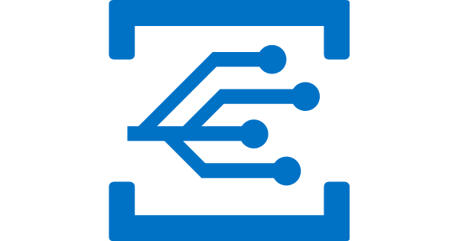

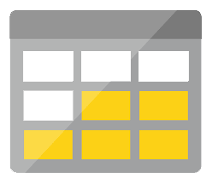
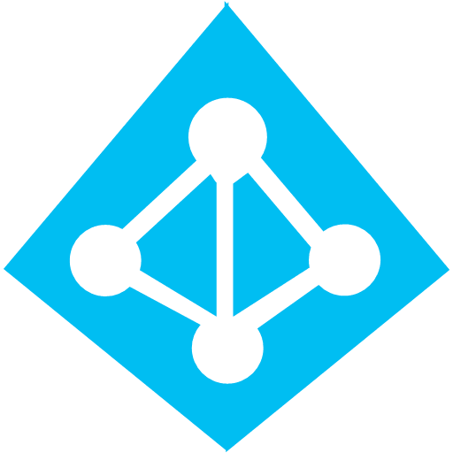
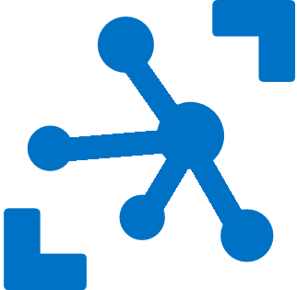


Azure serverless platform components
Platform
Event Grid
Logic Apps
Functions
Manage all events that can trigger code or logic
Design workflows and orchestrate processes
Execute your code based on events you specify
Database
Storage
Security
IoT
Analytics
Intelligence
Notes:
All of these services interoperate seamlessly with other Azure platform components, including databases like Azure SQL and Cosmos DB, storage services, security and identity, IoT, analytics, and even artificial intelligence. We’ll explore a machine learning integration later on.

Slide 14
Azure serverless platform components
Development
Platform
IDE support
Event Grid
Logic Apps
Functions
</>
Manage all events that can trigger code or logic
Design workflows and orchestrate processes
Execute your code based on events you specify
Integrated DevOps
Local development
Monitoring
Database
Storage
Security
IoT
Analytics
Intelligence
Visual debug history
Notes:
Of course developers want to be able to develop and test services locally, without an Internet connection, integrate these services with a mature DevOps pipeline and be able to both monitor and debug services that are already deployed to production. All of the Azure serverless platform components plug into your favorite development environment and enable local testing and remote debugging and telemetry.

Slide 15
Azure Logic Apps
Notes:
Let’s see what make Flow different then Azure Logic App.

Slide 16
Integration as a Services (iPaaS)
Fast integrations using a visual designer and workflow creation with triggers and actions
Connect applications, data, and services
Connect and orchestrate Azure Functions
Notes:
First Azure Logic App, is in Azure. It required an Azure subscription to get started and some functionalities will also require an integration account. With that special account it become a tool as powerful as BizTalk Servers that is well use in the big enterprises integration solutions.
Azure Logic Apps yes is more about workflow through a visual designer, but you will also be able to add pieces of code, have a control on the scalability and other more advanced features.

Slide 17
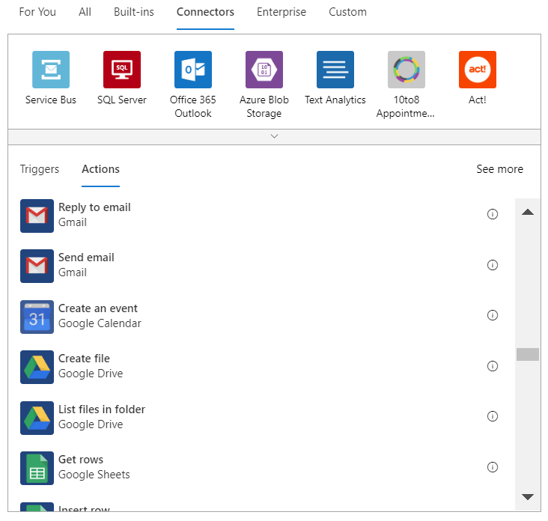
Hundreds of connectors for integrations
Notes:
Logic Apps have literally hundreds of integrations and support for custom integrations as well. You are able to integrate with Azure resources, database servers, SharePoint installations, Office 365, Dynamics, or third party resources like gmail, Twilio for text messaging or Slack for real-time communication.
In fact, there an internal joke saying that when you present a talk about iPaaS, the only slide that will NEVER be up to date is the connector slide… because there is always new ones.
Even more, today you can create custom connector. SO for example you could create a connector for your application and distribute it via the Azure Marketplace.

Slide 18
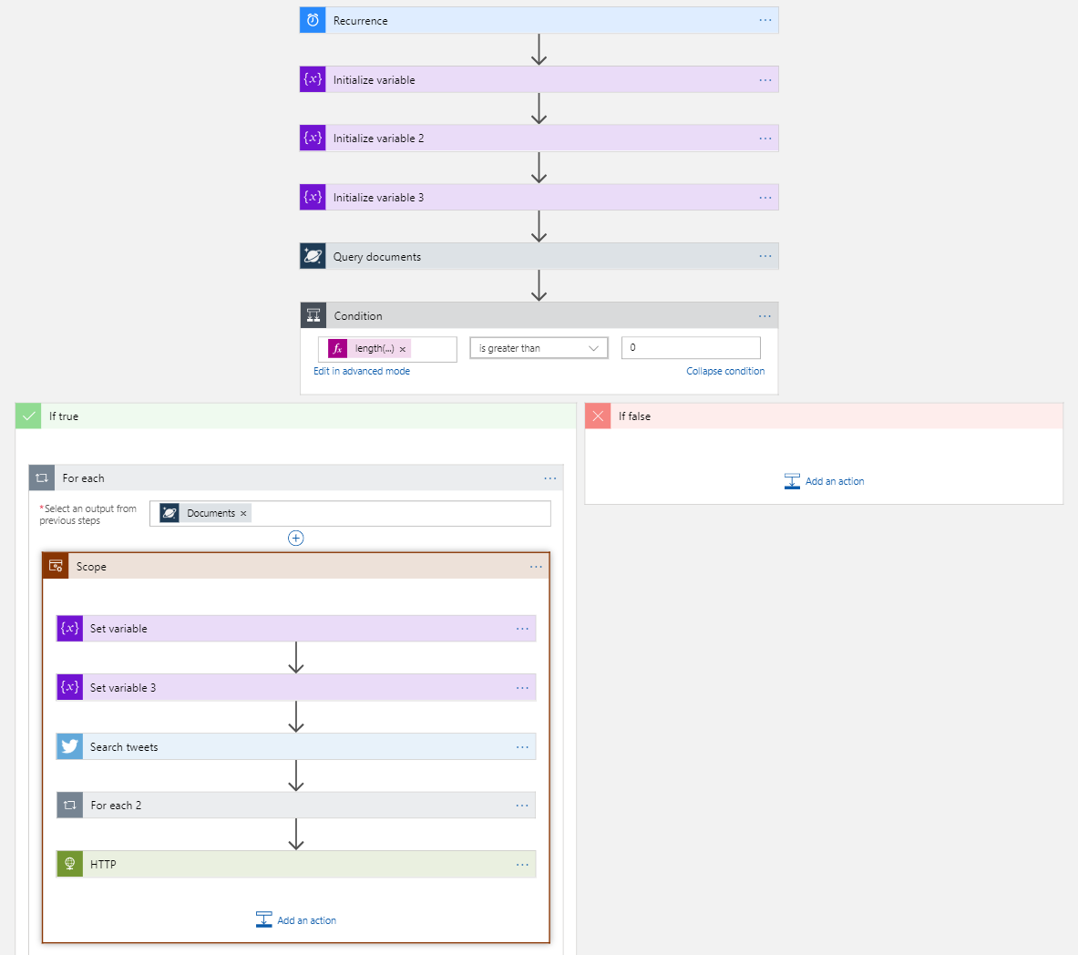
Visual workflow designer
Notes:
The integrations and workflows are all done within a visual designer that makes it easy to integrate, but also loop and branch on decisions so that you can manage different scenarios and edge cases.
It always start with a trigger. Here for example it start with a time trigger. SO let’s say every 2 minutes the workflow will start and initialize a few variables, execute a query in a Cosmo Database and if it found something will loop through the result connect to Twitter, do some HTTP call…. Etc. etc…

Slide 19
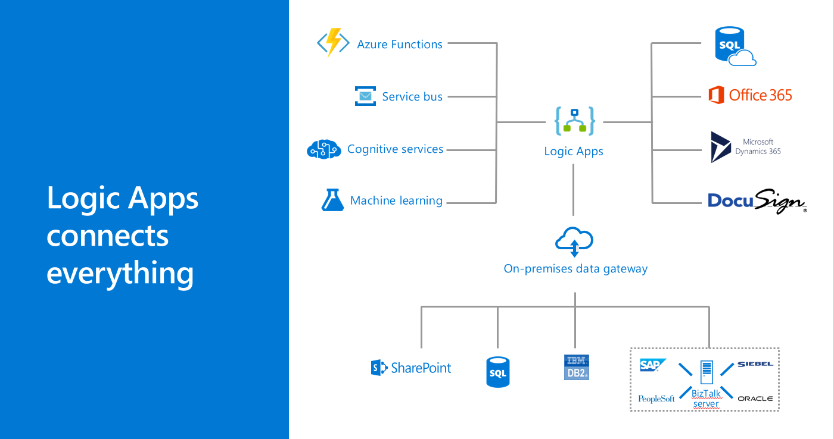
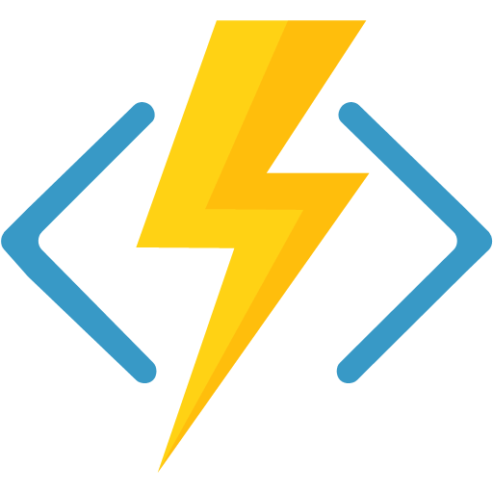
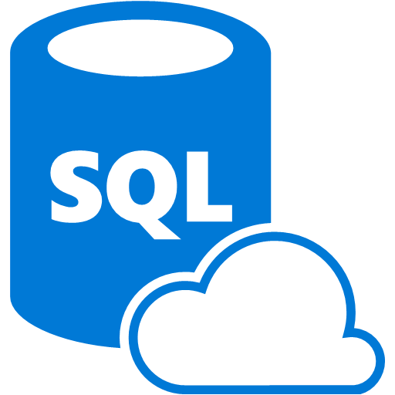

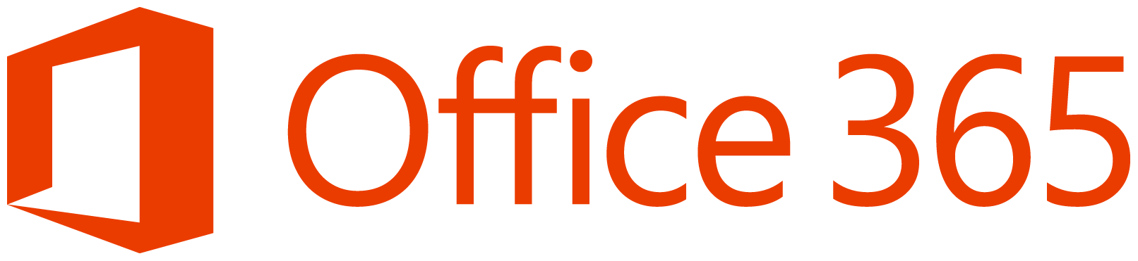

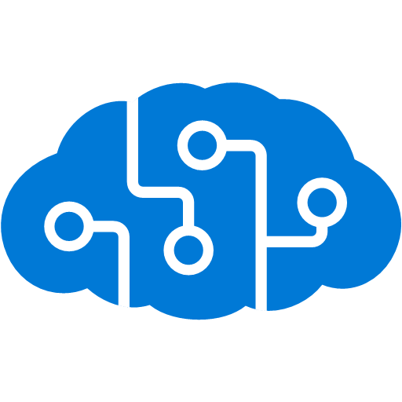
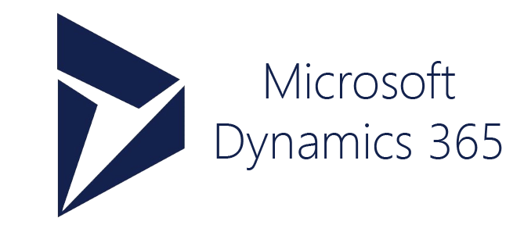


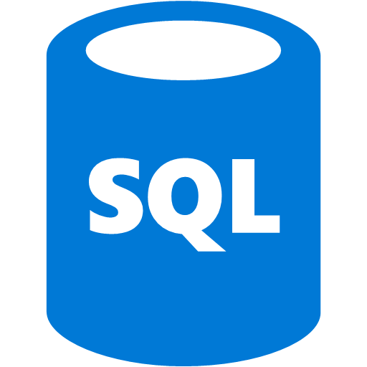
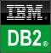
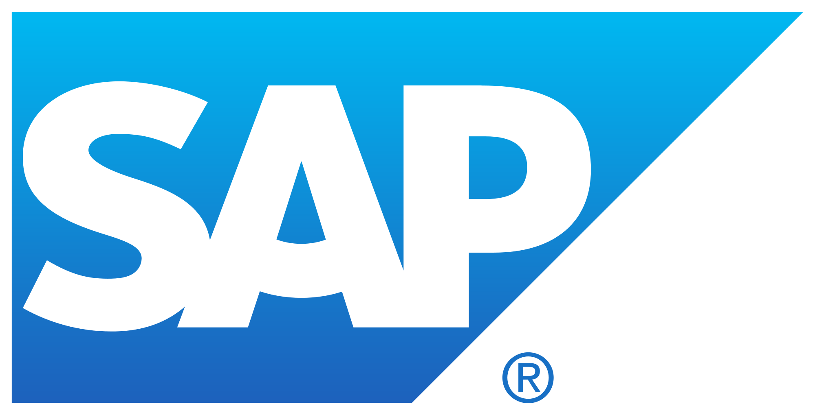


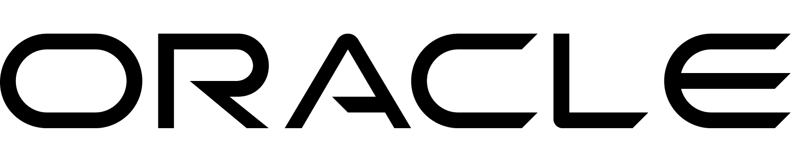
Logic Apps connects everything
Azure Functions
Service bus
Cognitive services
Logic Apps
Machine learning
On-premises data gateway
BizTalkserver
Notes:
Logic apps are great at connecting resources across the cloud, but they are also capable of integrating with on-premises resources with the on-premises data gateway. That means you can, for example, kick off a workflow in the cloud that results in the execution of a store procedure on your SQL database tucked away in your corporate data center.

Slide 20
Logic App Demo
Notes:
Let me show you a nice demo of an Azure Logic App

Slide 21
Azure Functions
Notes:
Now that we cover the workflows, let’s jump into something more code related with Azure Functions

Slide 22




Introducing Functions
Code
Azure Functions
Events
Notes:
The first example you saw was functions. Functions are literally code and events. And now I’ve revealed a carefully guarded secret: you know where the functions logo came from!

Slide 23
Why Azure Functions?
1
Supports C#, Node/JavaScript, Python, F#, PHP, PowerShell, Bash, Batch
2
Supports NuGet and NPM
3
Can even run EXE’s or call into DLL’s
Notes:
Why should you care about Azure Function.
- First, what languages are you coding? C#, JavaScript/ node, python, php, or “just” some bash? There is tons of languages already supported in Function and the product team continue to add new one. Recently PowerShell was added to the mixt. There is some demo online that shows how you can monitor your own subscription using a few line of PowerShell executed in an Azure Function.
- The beauty of coding these day is that there is many library available online. Why re-inventing something if it already exist? Azure function support NuGet and NPM, so you can get all the package you need.
- Of course, not all packages are external. You can easelly refer to your DLL or even run some EXE (executable) from inside your Azure Function.

Slide 24
More reasons?!
Triggers
Blob Storage
Cosmos DB
Event Hub
HTTP
Queues
Service Bus
Timer
Webhook
Bindings
File
Table
Excel
OneDrive
Email
Mobile app
Notification
More…
Notes:
You need more?!
Although functions are great because they run at scale and only bill when they are active, the “secret sauce” is in triggers and bindings. This is what made it so easy to access the data from table storage and respond to a web event. Instead of standing up a web server, we simply wrote code that responded to a web trigger and were passed a class with all of the information we needed. Instead of scanning for a connection string, opening a database connection, and navigating to table, our binding passed us a class that was already primed to interact with table storage. There are dozens of triggers and bindings available and you can write your extensions as well.

Slide 25
Azure Functions is open source
github.com/azure/azurefunctions
Azure Functions Host
Azure Functions Core Tools (CLI)
Language workers (Node, Python, Java, etc)
Extensions (triggers, input and output bindings)
VS Code extension
… and more

Slide 26
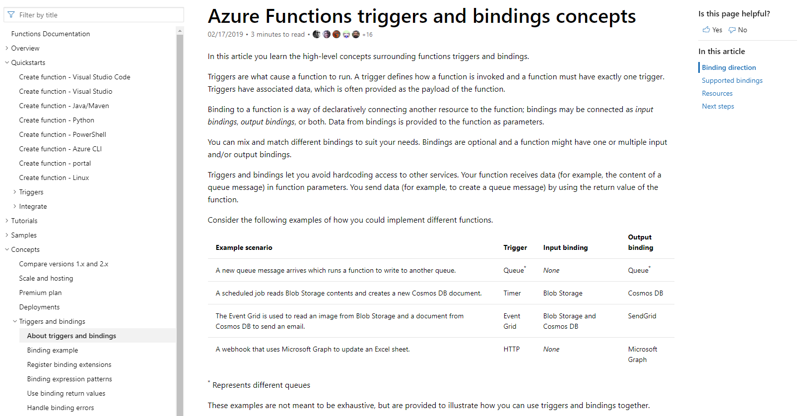
/Docs alert
Explore overviews, tutorials, samples, and more.
aka.ms/funcTriggers
Notes:
There is so much possibilities.. I invite you to go visit the Docs at aka.ms/funcTriggers to know more about the Azure Function triggers

Slide 27
Scenarios
Every 15 minutes
Find and clean invalid data
Clean table
File added to Blob Storage
Transform CSV to datarows
Power BI
Chart graphic
Notes:
Here are some of the scenarios we see serverless being used for. Have you ever had to find a scheduling service or install a special service just to run a job at a regular interval? You can trigger functions with a timer trigger and do things like purge expired web sessions from a table. Another common scenario is to trigger a function based on a blob storage event. For example, an ETL process may upload a CSV file that is then parsed, transformed into database rows and then analyzed with a Power BI dashboard.

Slide 28
Scenarios
Photo taken and WebHook called
Produces scaled images
PP
r
r
Stores in blob storage
Loaded web page calls WebHook
Create ad based on user profile
Completed page
C
r
Notes:
Another scenario might trigger from a photograph that is uploaded and this triggers code that automatically generates thumbnails. The last scenario is my personal favorite. You visit a web page, the page calls a function with your user profile and this gathers all of the data collected to deliver a personalized ad. This is why you do a web search for smart thermostat and suddenly see IoT ads everywhere you visit.

Slide 29
JavaScript Function Demo
Notes:
I talk a lot about the Azure Function now It’s time to go in a demo and see them in action.

Slide 30
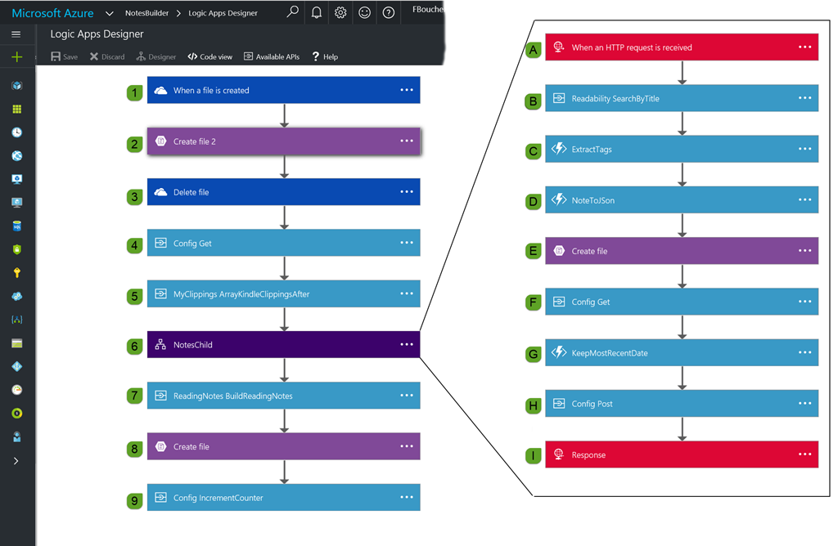
All together
Notes:
IF you have time go in details, otherwise you can just mention that Logic App can be more complexe and event call other logic Apps.
TO show you how all those services work all very well together…
Here an Azure Logic App created by an MVP to regroup reading notes saved in an eReader (in this case a Kindle) to generate a blog post automatically.
(it get trigger by a new file into a OneDrive folder, execute some Azure Function, even call another Logic App creates files into blob storage…. Etc.
The ReadingNotes Builder contains: Initial Trigger when a file is created in an OneDrive folder.
Create a copy of the file in an Azure Blob storage.
Delete the file in OneDrive.
Get the configuration file from Azure blob storage.
Call the API App responsible for parsing the file and extract the recent clippings.
Call the child Logic App for every clipping returned in the previous steps (foreach loop).
A. Trigger of the Child Logic App.
B. Call the API App responsible for searching in the online bookmark collection and return the URL of the article/ post.
C. Call Azure Function App responsible for extracting tags from the note.
D. Call Azure Function App responsible for converting the object in json.
E. Saves the json object in a file in Azure blob storage.
F. Gets the updated configuration file.
G. Call Azure Function App responsible for keeping the latest note date.
H. Update the configuration with the latest date.
I. Return an HTTP 200 code, so the parent Logic App knows the work is done.
Call the API App responsible for building the final markdown file.
Save the markdown file to an Azure blob storage that was returned at the previous step.
Update the config final.

Slide 31
Azure Logic App with Azure Function Demo
Notes:
Of course you could deploy manually using right-click and a few manual way. It worked well and it’s perfectly fine when developing, nut it doesn’t scale very well.
Let’s me show you how easy it is to setup quickly a Continuous integration, and continuous deployment (CI/CD) with GitHub.

Slide 32
GitHub Actions

Slide 33
GitHub Actions make it easy to automate all software workflows
Built-in to CI/CD
Event or schedule driven
Windows, Linux, macOS or containers
Built-in secret store
Easy to write, easy to share

Slide 34
Any languages
All major OS
Matrix builds

Slide 35
Powered by community
Deploy to any cloud
Create a ticket in JIRA
Publish a package to npm
Label a pull request
Welcome new contributors
Thousands of open source actions and workflow templates

Slide 36
Pricing
Simple, pay as you go

Slide 37
Workflows
Events
Actions

Slide 38
Workflow
A configurable automated process that you can set up in your repository
.github/workflows
YAML files (.yml or .yaml)
Build from scratch or use a template
Contains:
jobs > steps > commands or actions

Slide 39
Events
Workflows are triggered on events
GitHub Event
Issues, Comments, Push, Milestones, Forks, etc
Schedule
CRON syntax
External Event
Webhooks

Slide 40
Configuring events events
Runs workflow on push if push event includes file outside of `docs/` directory
Runs workflow anytime a Javascript file is pushed
on: push: paths-ignore: - 'docs/**'
on: push: paths: - '**.js'

Slide 41
Actions
Individual unit of work that you combine as steps to create a job in a workflow
For example
actions/checkout
actions/cache
actions/javascript-action
Lots more on GitHub Marketplace

Slide 42

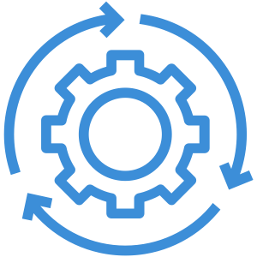


GitHub Actions + Azure
1
Authenticate
2
To Tasks
3
Deploy

Slide 43
Authentication
Two ways to auth to Azure:
Service Principle
Secret: AZURE_CREDENTIALS
Publishing Profile
Secret: SCM_CREDENTIALS
Set up build environment
- name: 'Login via Azure CLI' uses: Azure/actions/login@master with: creds: ${{ secrets.AZURE_CREDENTIALS }} - name: Setup Node 10.x uses: actions/setup-node@v1 with: node-version: '10.x'

Slide 44
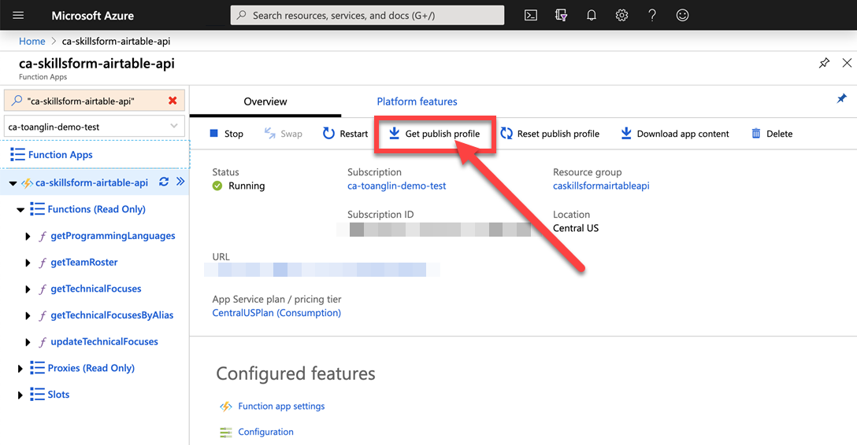
Publishing profile from Azure Portal

Slide 45
CLI create Service Principal
az ad sp create-for-rbac --name "<APP_NAME>" --role contributor --scopes /subscriptions/<SUBSCRIPTION_ID>/
resourceGroups/<RESOURCE_GROUP>/ providers/Microsoft.Web/sites/<APP_NAME> --sdk-auth

Slide 46
CLI create Service Principal
What if?!
az ad sp create-for-rbac --name "<APP_NAME>" --role contributor --scopes /subscriptions/<SUBSCRIPTION_ID>/ --sdk-auth

Slide 47
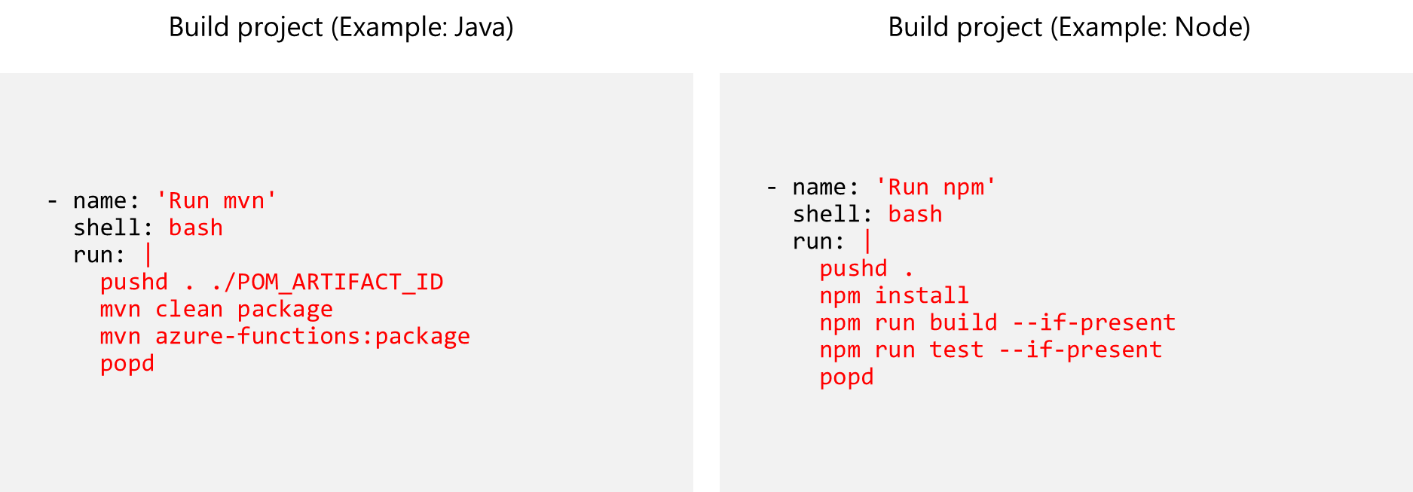
Build
Build project (Example: Java)
Build project (Example: Node)

Slide 48
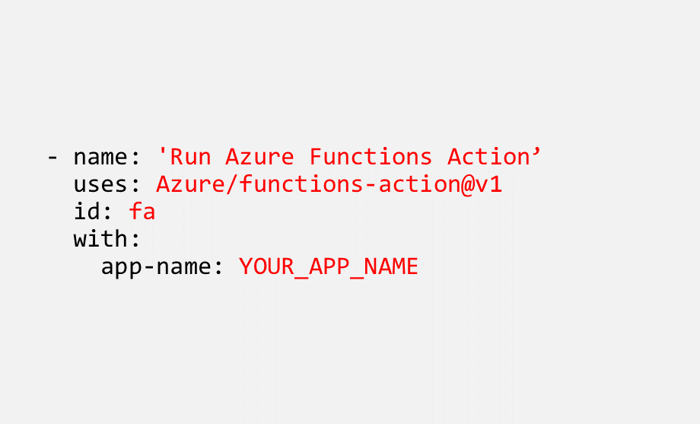
Deploy
Deploy to Azure
Use GitHub Action for Azure Functions
Configure with:
App name
Slot name
Path to directory
Publish profile secret

Slide 49
Deploy to Azure with GitHub Actions

Slide 50
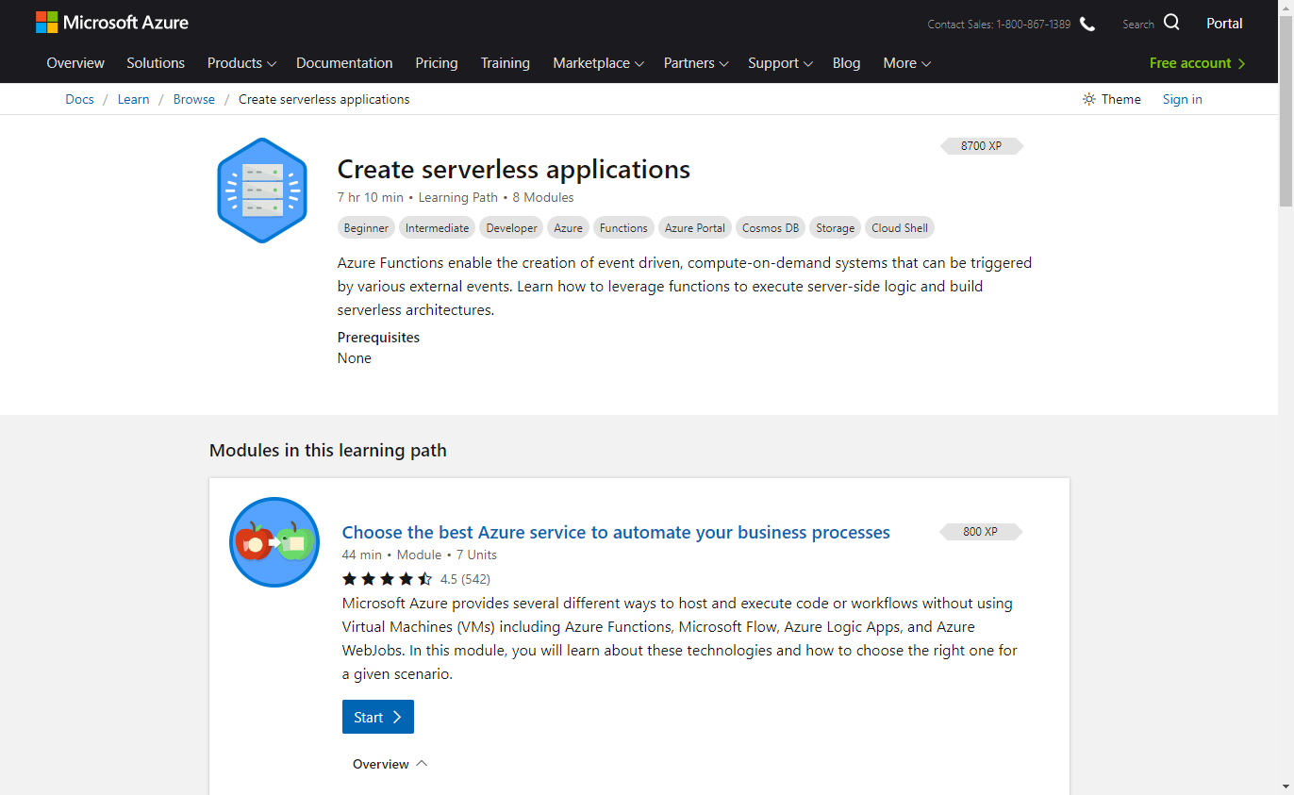
/MS Learn alert
Complete interactive learning exercises, watch videos, and practice and apply your new skills.
aka.ms/AFUN95MSLearnCollection
Notes:
There is an excellent Learning path on MS learn if you are interested to know more about how to create Serverless applications in Azure.

Slide 51

/MS Learn
Complete interactive learning exercises, watch videos, and practice and apply your new skills.
aka.ms/AFUN95MSLearnCollection

Slide 52
Invent with purpose.

